Slide 1

Alkanes
Naming, isomers, properties and reactivity

Slide 2

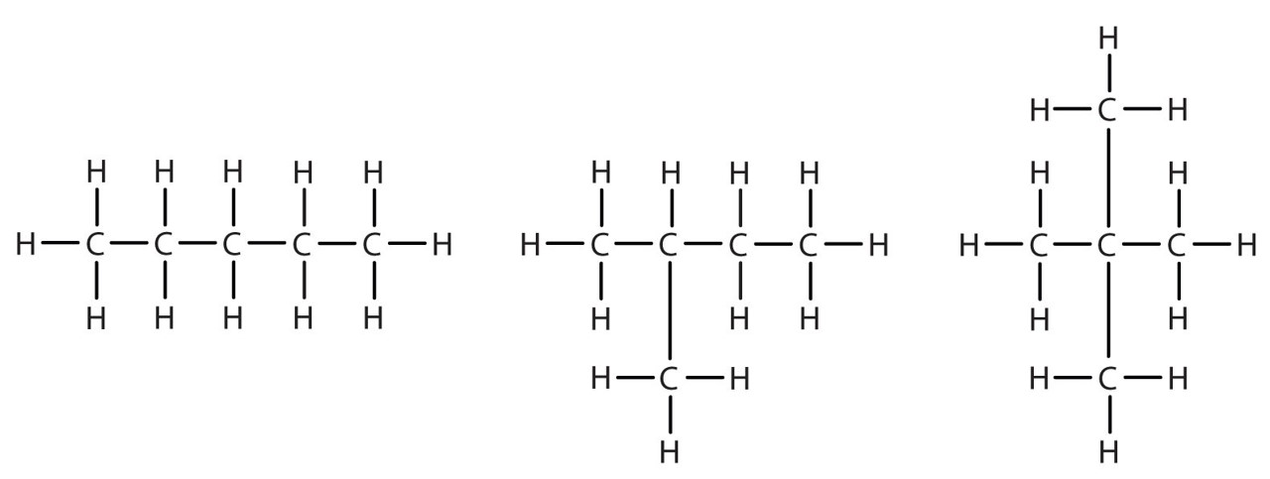
Alkanes - introduction
Alkanes are saturated hydrocarbons (contain only single bonds)
General formula:
C_{n}H_{2n+2}
Alkanes can be Straight or Branched

Slide 3
Alkanes - naming
In order to identify hydrocarbons a set of naming rules was created (IUPAC)
A series of prefixes, stems and suffixes were used to identify the number of C atoms present and their position
CH₄
methane
stem
suffix
Suffix – gives the class of hydrocarbon
Stem – gives the number of carbons in the molecule

Slide 4
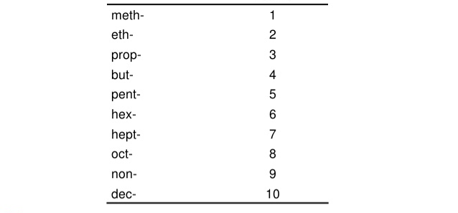
Alkanes - naming
Suffix for Alkanes: -ane
Stem (indicate the number of carbons):
Number of carbons
Stem
You need to remember this, maybe you can use a mnemonic device?

Slide 5
Alkanes - naming
pentane
How do I name this compound?

Slide 6
Alkanes - naming
Main chain
Side groups or functional groups
Suffix – gives the class of hydrocarbon
Stem – gives the number of carbons in the main chain
2-methylbutane
prefix
stem
suffix
Prefix – gives the side groups
Need to know – Alkyl groups and Halo groups
*note – we use numbers to indicate the position*

Slide 7
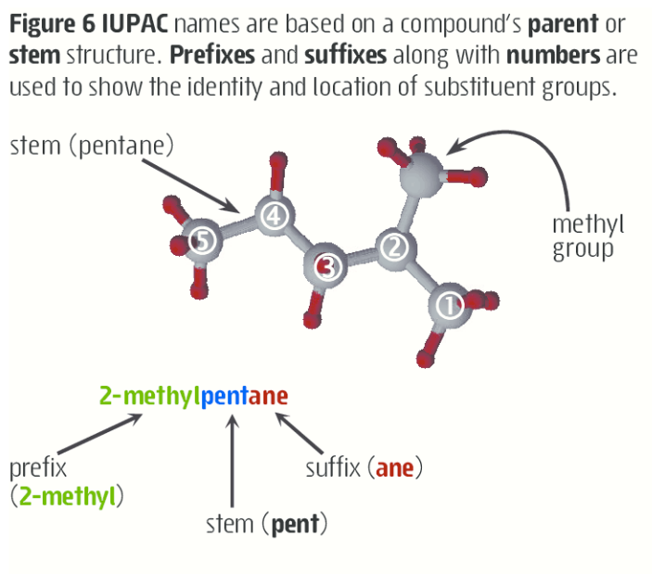
Alkanes - naming

Slide 8
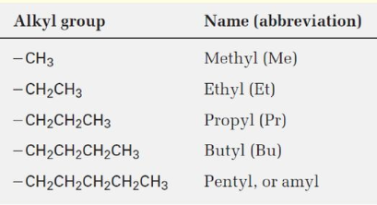
Alkanes – side chains
Alkyl groups
stem name based on the number of carbons
suffix of -yl
Halo groups
Stem name based on the halogen
Suffix of -o
Halo group | Name
-Cl | chloro
-Br | bromo
-I | iodo
-F | fluoro

Slide 9
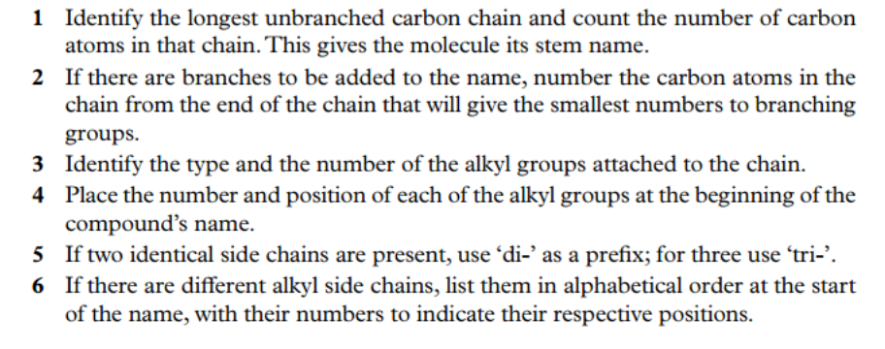
Alkanes – naming steps

Slide 10
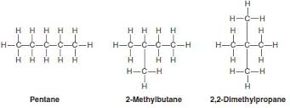
Alkanes - isomers
Molecules can have the same molecular formula but a different structural formula
Chain isomers – have same molecular formula but the number of carbon in the main chain varies

Slide 11

Alkanes - isomers
Molecules can have the same molecular formula but a different structural formula
Chain isomers – have same molecular formula but the number of carbon in the main chain varies
Position isomer – have same number of carbons in the main chain but the position of any branches is different

Slide 12
Alkanes – Practice questions
You should have completed the naming and drawing worksheet from last term. Should also be working on Pearson review 8.1

Slide 13
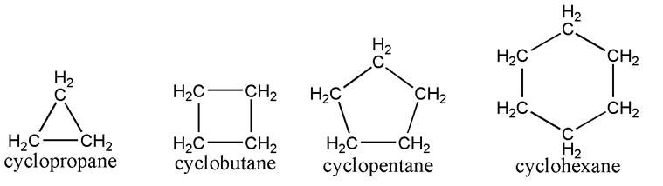
Alkanes – cycloalkanes
Hydrocarbons that form ring structures (rather than chains) are called alicyclic hydrocarbons. They have similar nomenclature and chemical properties as their aliphatic counterparts.
General formula: C_{n}H_{2n}
Learn to draw the following cycloalkanes:
3 cyclopropane
4 cyclobutane
5 cyclopentane
6 cyclohexane
8 cyclooctane

Slide 14
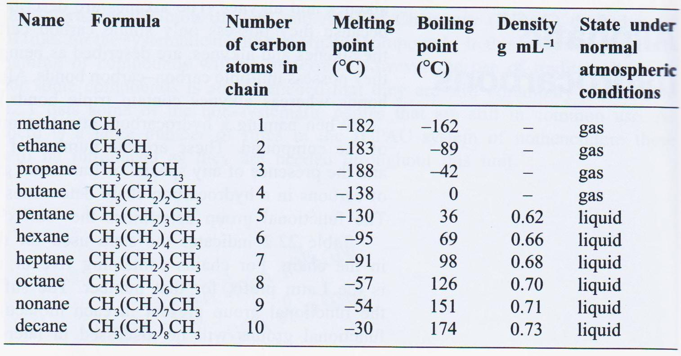
Alkanes - properties
Observable trends - as the molecular mass increases:
Melting point increases
Boiling point increases
Density increases
Alkanes are insoluble in water, but soluble in non-polar solvents.

Slide 15
Alkanes - reactions
Combustion
Alkanes and cycloalkanes react with O₂ to produce water, carbon dioxide and energy
Source of the majority of our fuels due to the high amount of energy released
Have a large activation energy, so they require an “ignition” source (a spark) to start the reaction.
Balance the following combustion reaction for octane, a common constituent of petrol:
C₈H_{18(l)} + O_{2(g)} → H₂O_{(g)} + CO_{2(g)} + large amount of energy

Slide 16
Alkanes - reactions
Incomplete Combustion
Combustion in limited supply of oxygen produces CO and water.
Write the balanced combustion reaction for octane in limited supply of oxygen:
2 C₈H_{18(l)} + 17 O_{2(g)} → 18 H₂O_{(g)} + 16 CO_{(g)} + energy (not as much)

Slide 17
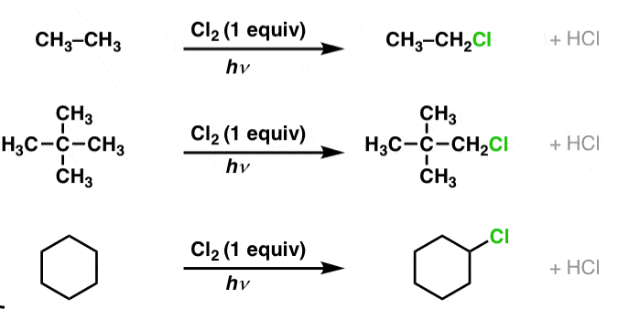
Alkanes - reactions
Substitution reactions
A hydrogen is replaced by another element (e.g. a halogen) eg: CFC’s
Halogen substitution reactions are slow, and facilitated by UV light.
Product mixture depends on relative concentration of the halogen (use an excess you will get complete substitution).

Slide 18
Alkanes - reactions
Substitution reactions
chloromethane
dichloromethane
trichloromethane
tetrachloromethane

Slide 19
Alkanes – Essential Chem Questions
Pearson 8.1 plus 8.1 review questions
STAWA set 40, 41 and 42 – they combine alkanes, alkenes and aromatic compounds so you can begin selected questions.

